Slide 1

Sales Data Analysis & Dashboard
Project Presentation
Riya Kumari | Data Analytics

Slide 2
Problem Statement
Many companies have huge amounts of sales data but don't use it effectively.
Difficulty in Tracking: Managers find it hard to check the overall sales performance in one easy place.
The Goal: I needed to create a simple, clear dashboard to track sales and help managers make better, faster business decisions.

Slide 3
Project Objectives
My project involved several key steps:
Collect and Clean the sales data to remove errors and duplicates.
Analyze the data and calculate important statistics (like totals and percentages).
Create different charts and graphs to easily study sales trends.
Design an interactive dashboard to display all results clearly.
Suggest useful recommendations for improving sales decisions.

Slide 4
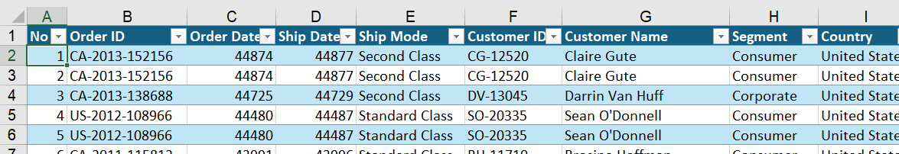
Raw Data Structure
The analysis was based on a large dataset of company sales records.
Source: Company sales records (Excel).
Volume: More than 90,000 rows of sales data.
Key Columns: Order ID, Order Date, Customer ID, Region, Category, Sub-Category, Product Name, Sales, Quantity, Discount, and Profit.

Slide 5
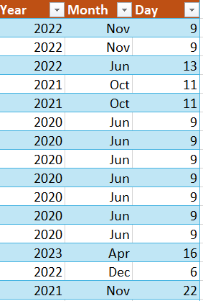
Data Cleaning & Preparation
A critical step was ensuring data quality and readiness in Excel.
Cleaning:
Removed missing or incorrect values.
Deleted duplicate records.
Corrected spelling and formatting inconsistencies.
Preparation:
Added new time-based columns for analysis:
Year: =YEAR([Order Date])
Month: =TEXT([Order Date],”mmm”)
Day: = DAY([Order Date])
Formatted the new columns for visibility.

Slide 6
Creating Pivot Tables and Metrics
I created over 10 Pivot Tables to summarize the data:
Pivot Table Focus Areas: Monthly Sales & Profit, Quantity by Category, Sales by Segment, Region, City, and Top 10 Products.
Key Performance Indicators (KPIs):
Total Sales
Total Profit (Total Margin)
Margin % (calculated as Total Margin / Sum of Sales)
Quantity
Formula Used: I used the GETPIVOTDATA function to link these KPIs directly to the Pivot Tables for automatic updates.

Slide 7
Dashboard Design & Key Metrics
I designed the dashboard using Excel shapes and alignment tools.
A consistent font (Calibri) and clear color highlights were used.
KPIs are presented in clean, rounded rectangles with icons.

Slide 8
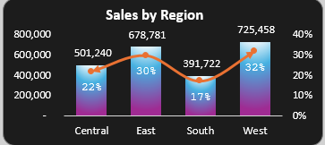
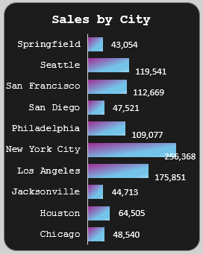
Regional Sales Performance
Sales by Region (Combo Chart): This chart shows sales totals (bars) and their percentage share (line).
Best Region: West, with the highest sales ($725,458) and a 32% share.
Second Best: East (30% share).
Lowest Region: South (17% share).
Sales by City (Bar Chart):
Highest Sales: New York (256,368 units).
Lowest Sales: Springfield, Jacksonville, San Diego, and Chicago.

Slide 9
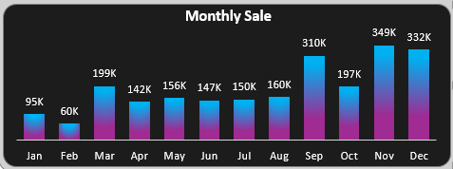
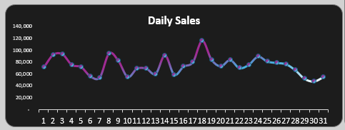
Monthly and Daily Sales Trends
Monthly Sales (Column Chart):
Peak Sales Months: November (349K) and December (332K), suggesting strong end-of-year performance.
Lowest Sales Month: February (60K).
Mid-year sales are steady (142K–160K).
Daily Sales (Line Chart):
Shows sales fluctuations each day of the month with clear peaks and drops.
Helps quickly identify high and low sales days for operational planning.

Slide 10
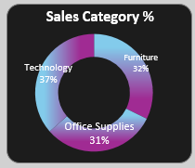
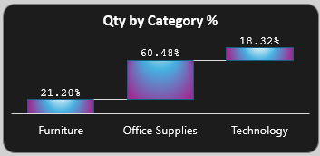
Category Performance (Sales vs. Quantity)
Sales Category % (Donut Chart): Shows revenue share by category.
Highest Revenue: Technology (37%).
Furniture (32%) and Office Supplies (31%) are closely ranked.
Quantity by Category % (Waterfall Chart): Shows volume share.
Highest Quantity: Office Supplies (60.48%).
This contrast highlights that while Office Supplies sell the most units, Technology generates the highest revenue.

Slide 11
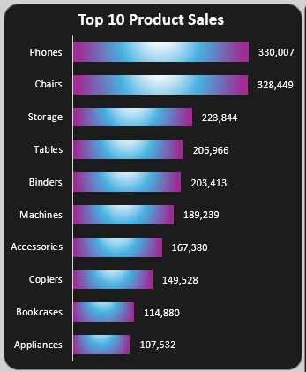
Top Products and Customer Segments
Top 10 Product Sales (Bar Chart):
Best Sellers: Phones ($330,007) and Chairs ($328,449).
Storage, Tables, and Binders also performed well.
Appliances and Bookcases had the lowest sales in this group.

Slide 12
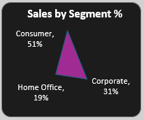
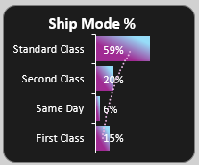
Customer Segments & Shipment Analysis
Sales by Segment % (Radar Chart):
Dominant Segment: Consumer (51%).
Corporate (31%) and Home Office (19%) follow.
Ship Mode Percentage (Bar Chart):
Most Used: Standard Class (59%).
Second Class (20%) and First Class (15%).
Least Used: Same Day (6%).
This insight helps compare customer shipping preferences and analyze the cost-effectiveness of different shipping options.

Slide 13
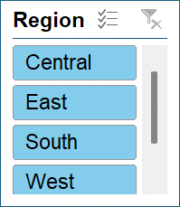
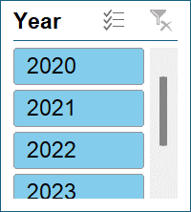
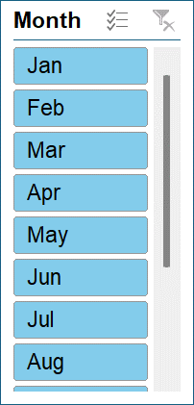
Interactive Features (Slicers)
I added Slicers to make the dashboard fully interactive.
Slicers allow users to filter data instantly by:
Region (Central, East, South, West).
Year (2020–2023).
Month (Jan to Dec).
Benefit: Slicers are connected to all Pivot Tables and charts, allowing for quick, smart decision-making and analysis.

Slide 14
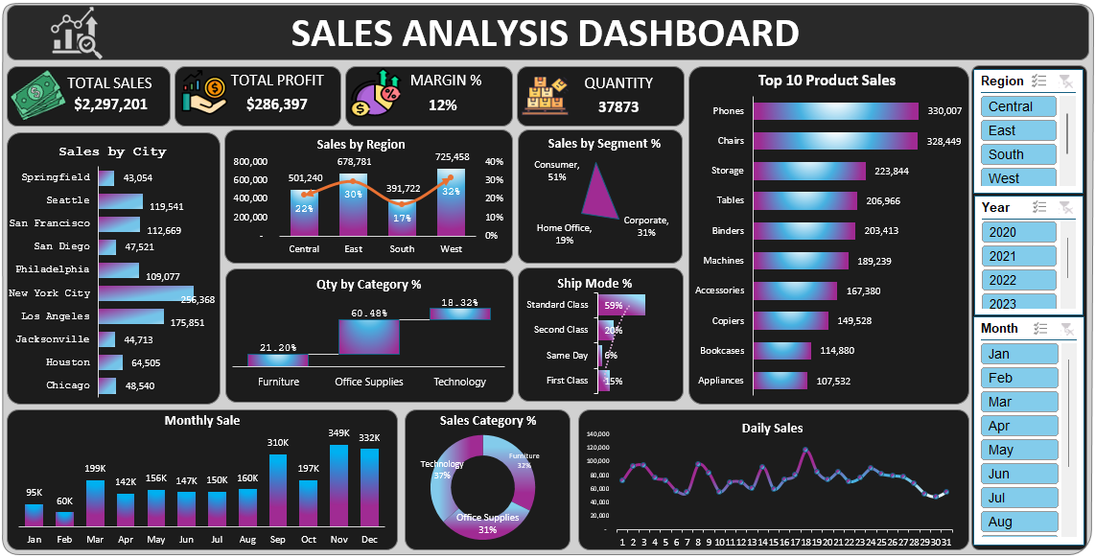
Final Dashboard Demonstration
This is the final, complete Sales Analysis Dashboard. It clearly shows:
The main KPIs right at the top.
The slicers on the left for easy filtering.
Nine different charts summarizing performance by region, product, time, and shipping method.
It's a reliable, user-friendly tool that helps a retail business with reporting and decision-making.
.

Slide 15
Key Recommendations
Based on the dashboard insights, I recommend the business should:
Focus on Top-Performing Areas: Increase marketing and resources in the West Region and cities like New York.
Promote Best-Sellers: Ensure high stock and aggressively promote Phones and Chairs to increase revenue.
Optimize Shipping: Analyze why Standard Class is so dominant and look for ways to improve performance or reduce cost for other methods.
Target Low Segments: Create specific marketing plans for the Home Office segment (the lowest performing).
Maintain the Dashboard: Keep the tool updated regularly for accurate, real-time insights.

Slide 16
Conclusion
The Excel Sales Dashboard successfully delivers on its objectives.
Clarity: It simplifies large sales data into easy-to-understand visuals and key metrics.
Interactivity: The use of slicers enables quick, smart, and data-driven decision-making for managers.
Skill Demonstration: This project showcases strong foundational skills in data analysis, Excel visualization, and business reporting.

Slide 17
THANK YOU

